Slide 1
Where project
By cameo

Slide 2
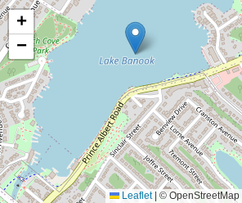
personal
For my personal location I choose lake banook
Because even though I don't actually paddle there
I spend a lot of time there every summer. It's a great
Place to go with friends, family or meet new people.
I love walking around, going swimming and taking
Pictures overall it's a great place and one of my favorites.

Slide 3
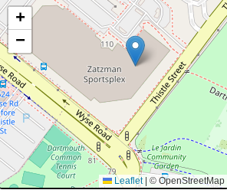
community
For my community location I choose sportsplex
Because I go there alot after school and with friends.
I love going tere because theres so much stuff to do
And you never get bored. My favoritr is when they
Have open gym because you can do whatever you
Want and i usually play volleyball or basketball. Overall
Its a great place and very fun.

Slide 4
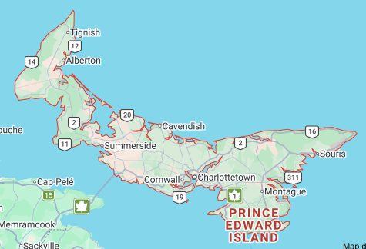
global
I choose pei because it's a big part of my
Family, we have a cottage there so we go
Down every summer. I love going there and
Seeing all of my family because its super
Fun. My favorite thing to do is go to the water
park . I've been going there since I was around
Six and I look forward to going every year.

Slide 5
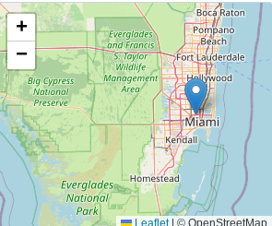
aspirational
I choose Miami as my dream vacation spot because its
Super warm and tropical there. I've always wanted to
Travel the world but this is one of my dream locations
To go to. I love the beach so if I ever went there I would
Be in the water all day everyday. All in all I would love
To be able to experience going there someday.

Slide 6
Sound track
Taylor swift-shake it off
https://www.youtube.com/watch?v=Z4A9ZZo_rAE
I choose this song because when I think about my childhood I think about taylor swift. I loved to listen to her especially this song. Thats why its a big part of my childhood and this song brings back so many childhood memories like listening to it in the car,house,etc.

